Slide 1

eduAv: Front-End Prototype
After making a selection in the Python program, please build your personalised eduAv !

Slide 2




Skin Tone Choices [1/1]:

Slide 3






Eye Choices [1/1]:

Slide 4



Nose Choices [1/1]:

Slide 5



Mouth Choices [1/1]:

Slide 6

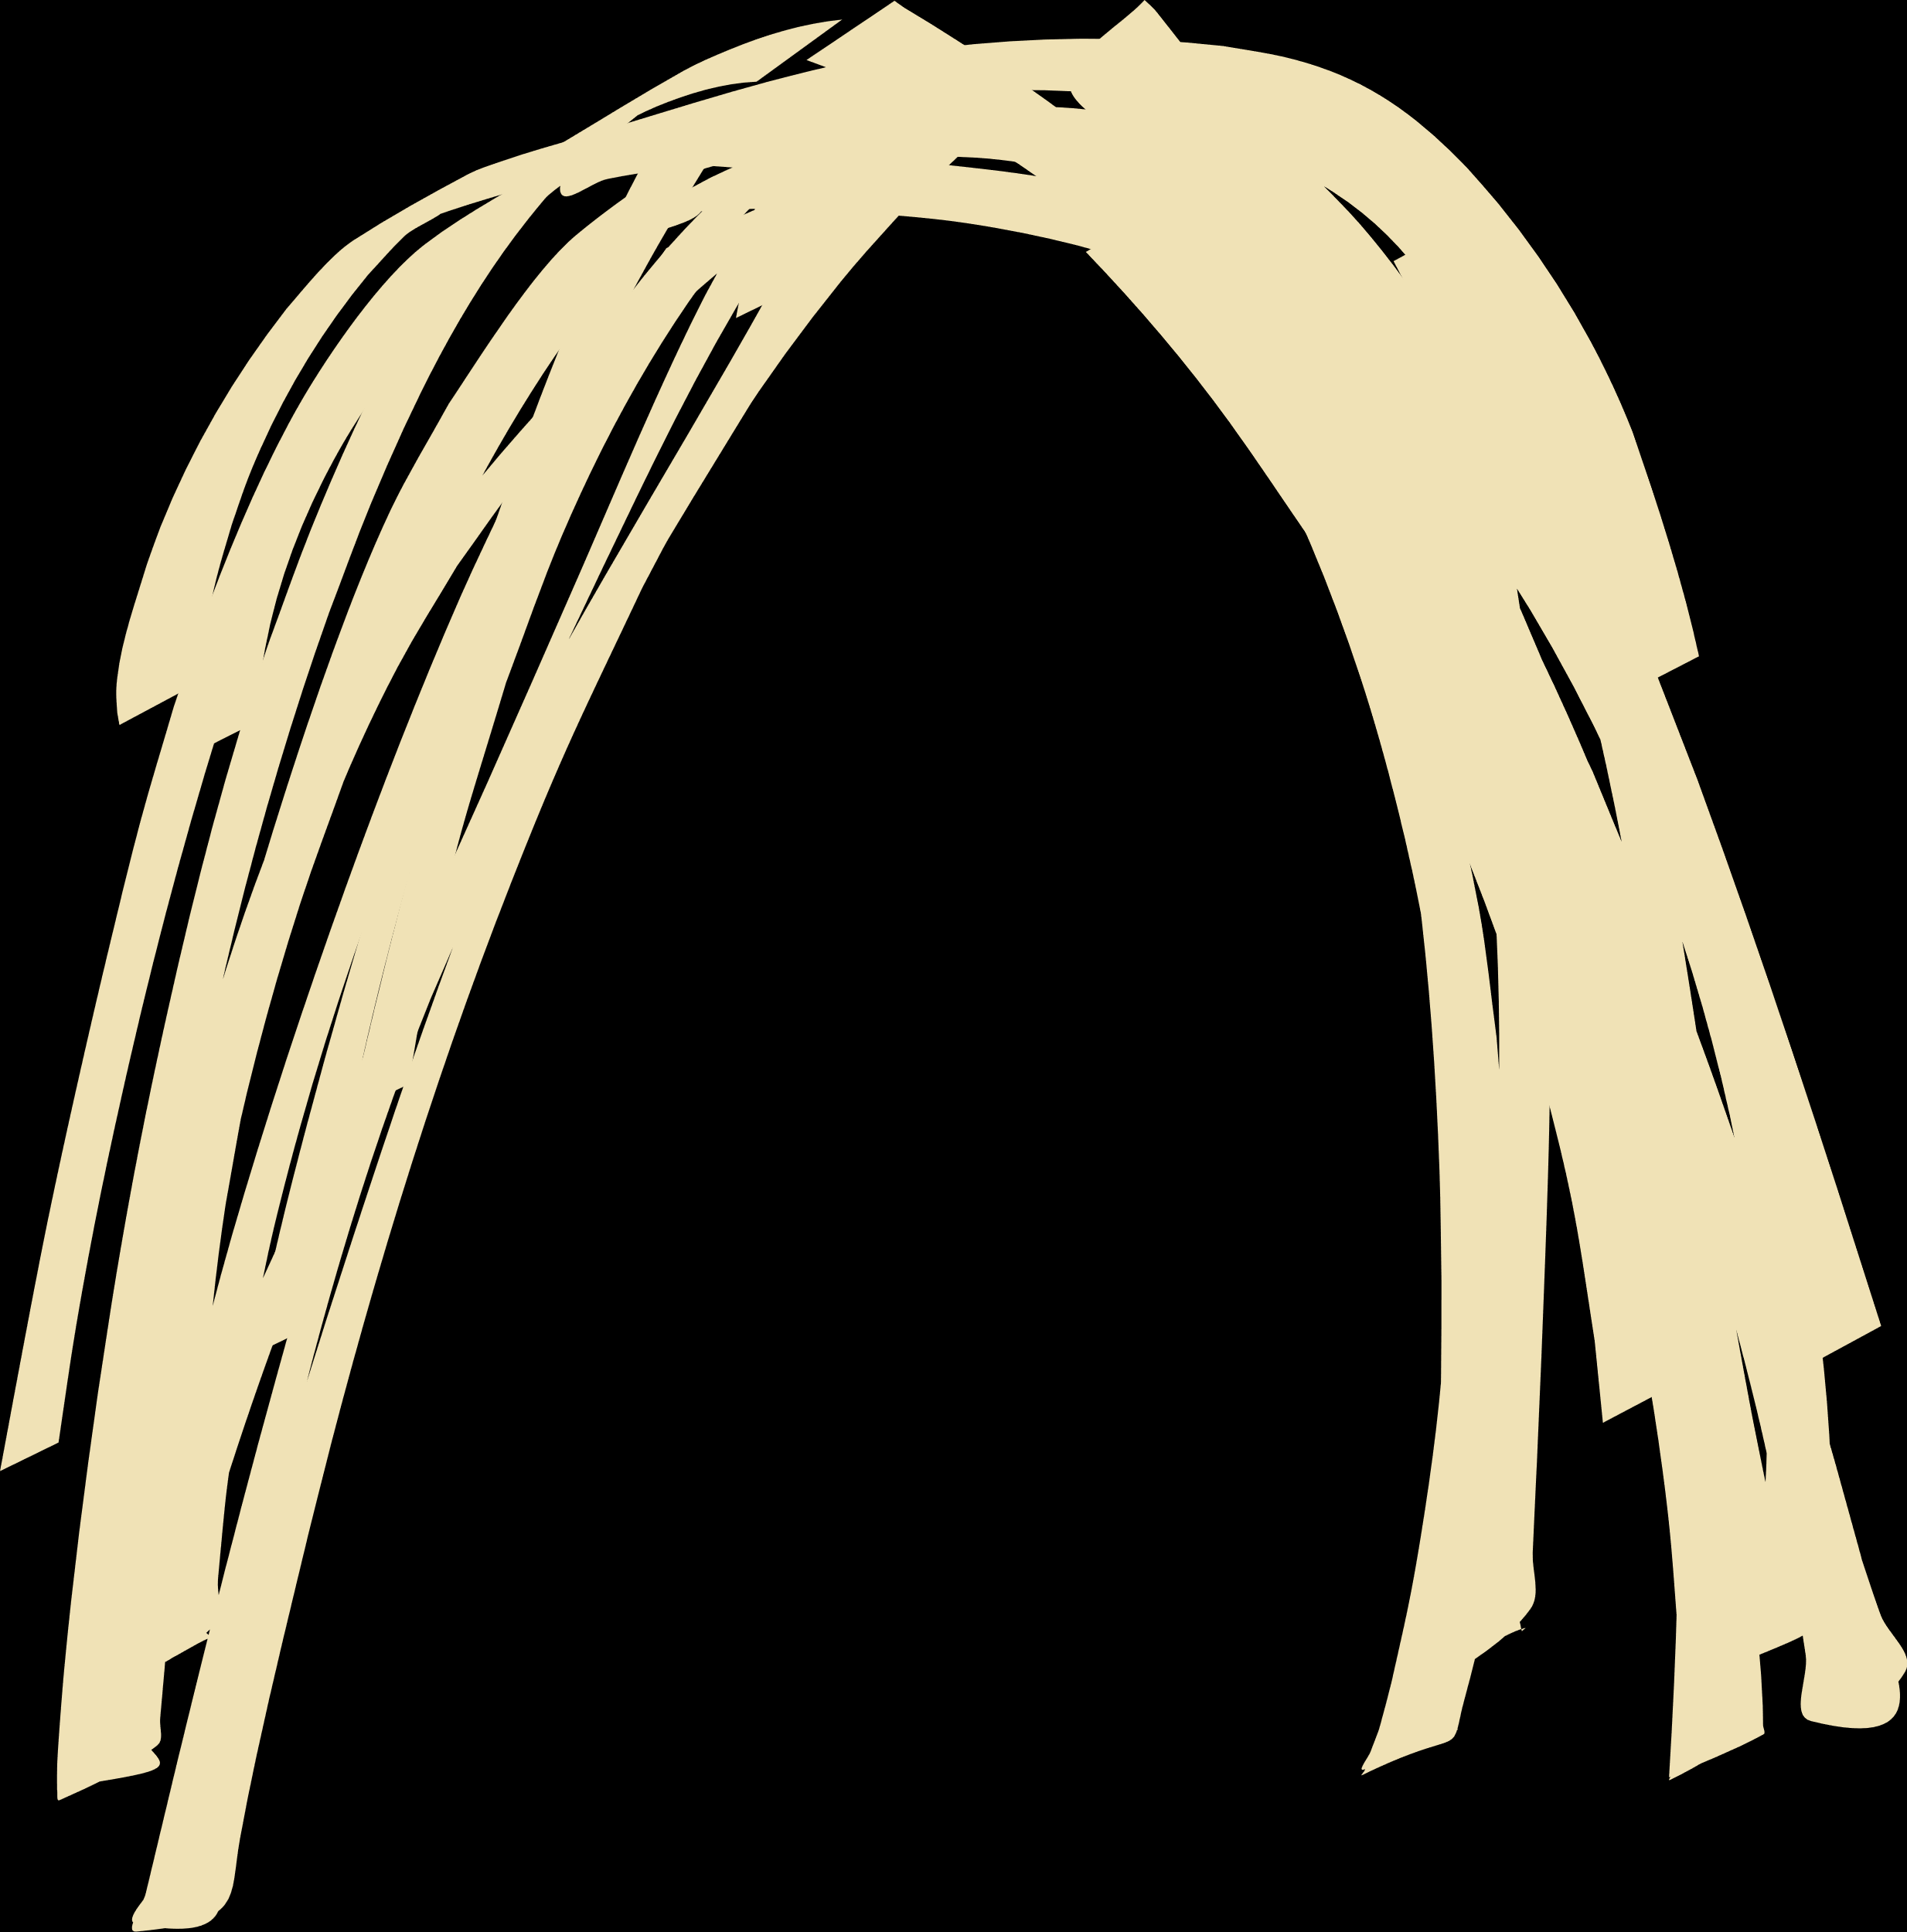
Hair Choices [1/3]:

Slide 7


Hair Choices [2/3]:

Slide 8


Hair Choices [3/3]:

Slide 9
STOP! NEXT SLIDE ARE OTHER PEOPLE’S CREATED eduAVS

Slide 10
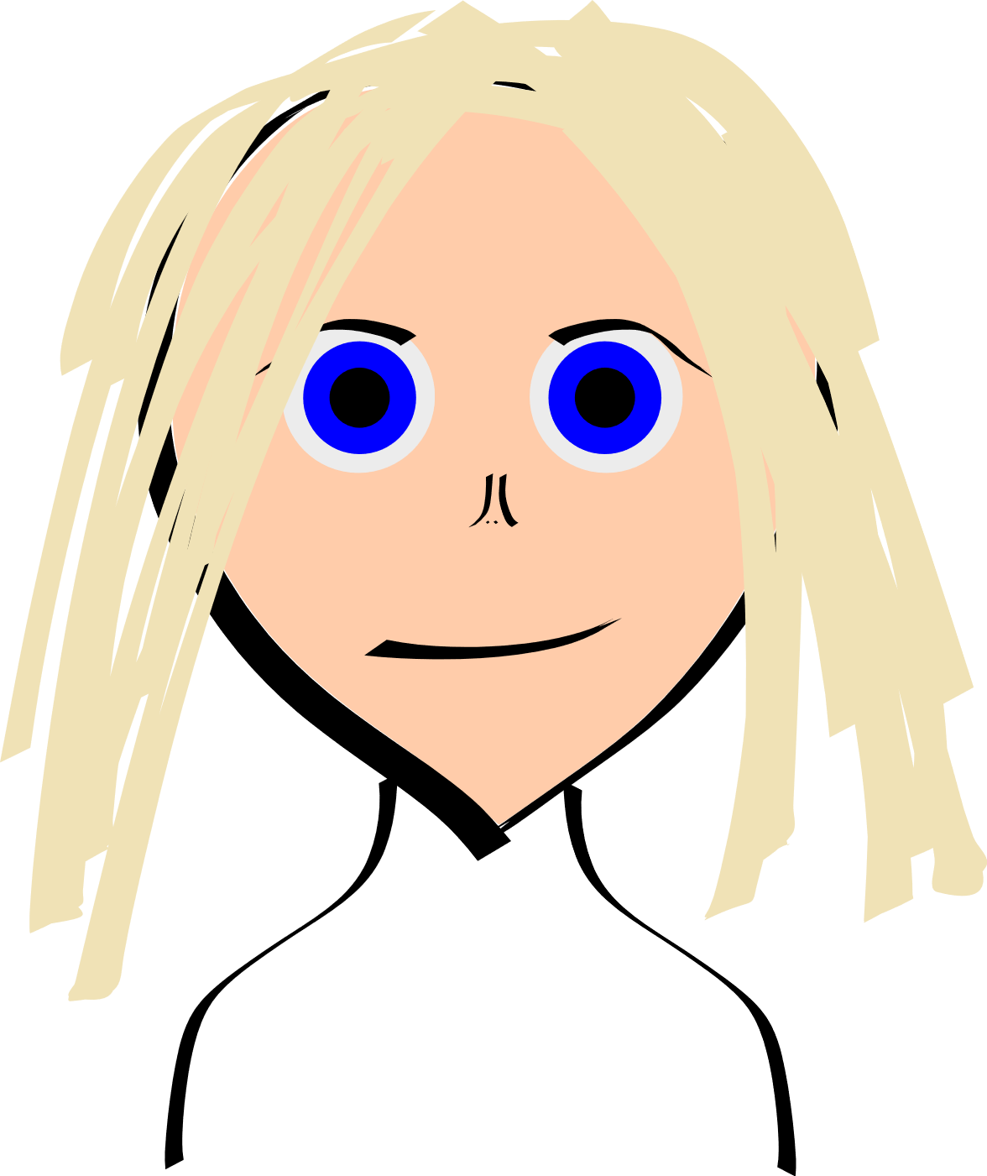
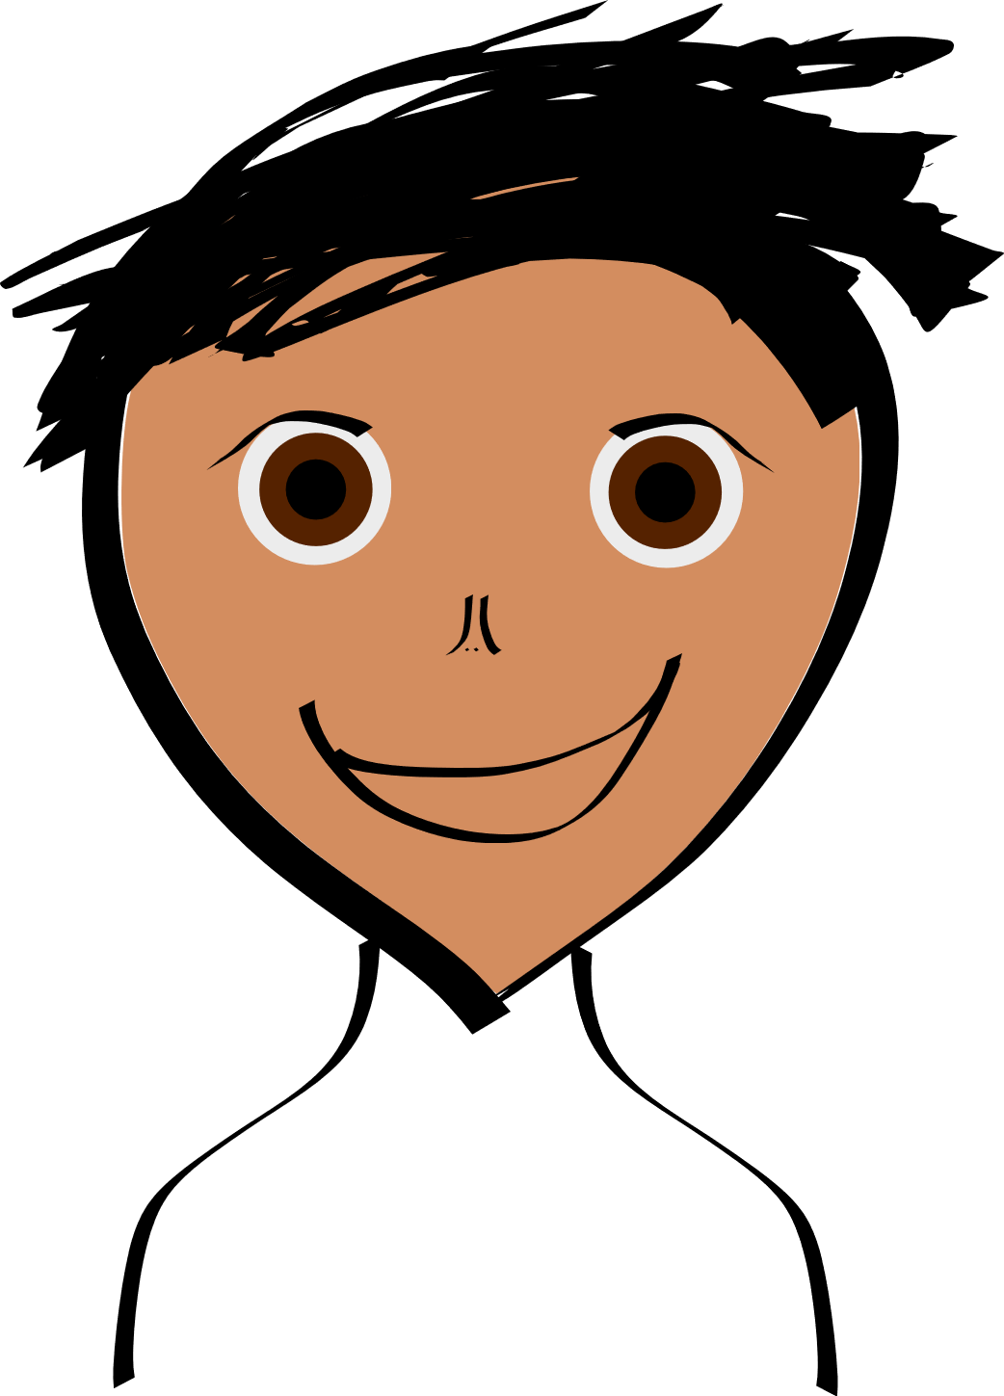
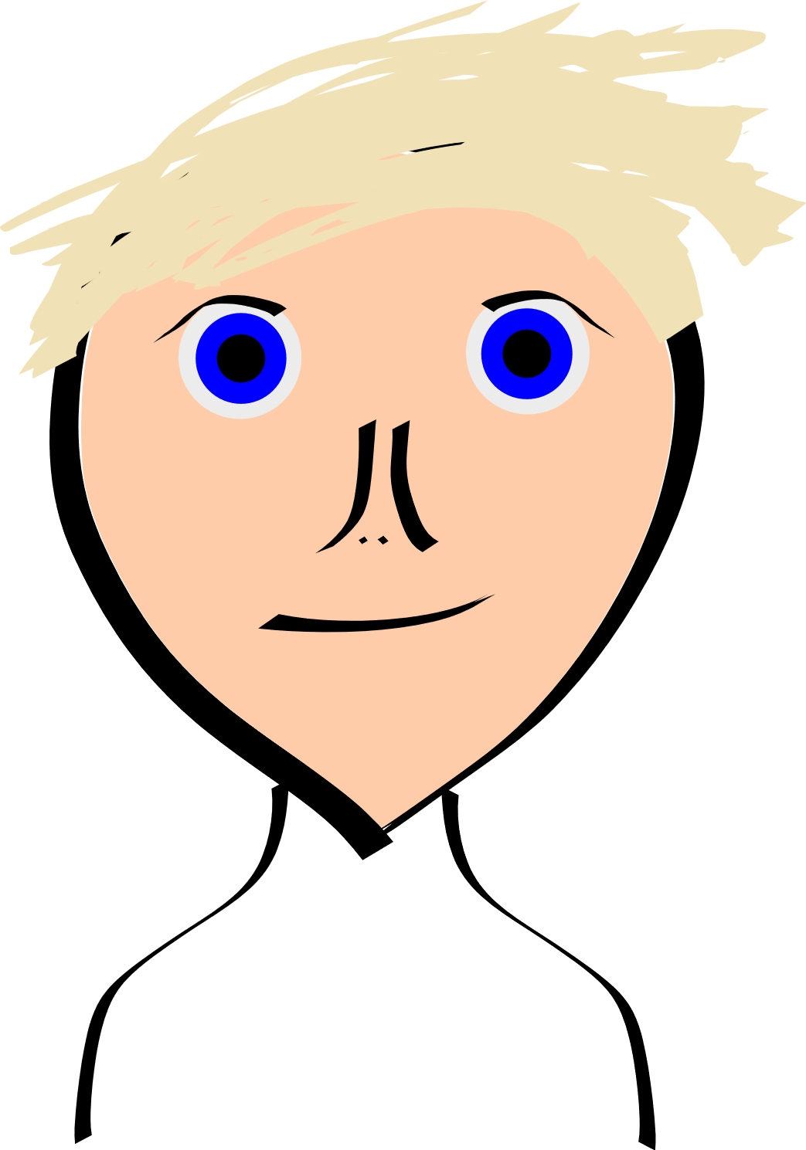
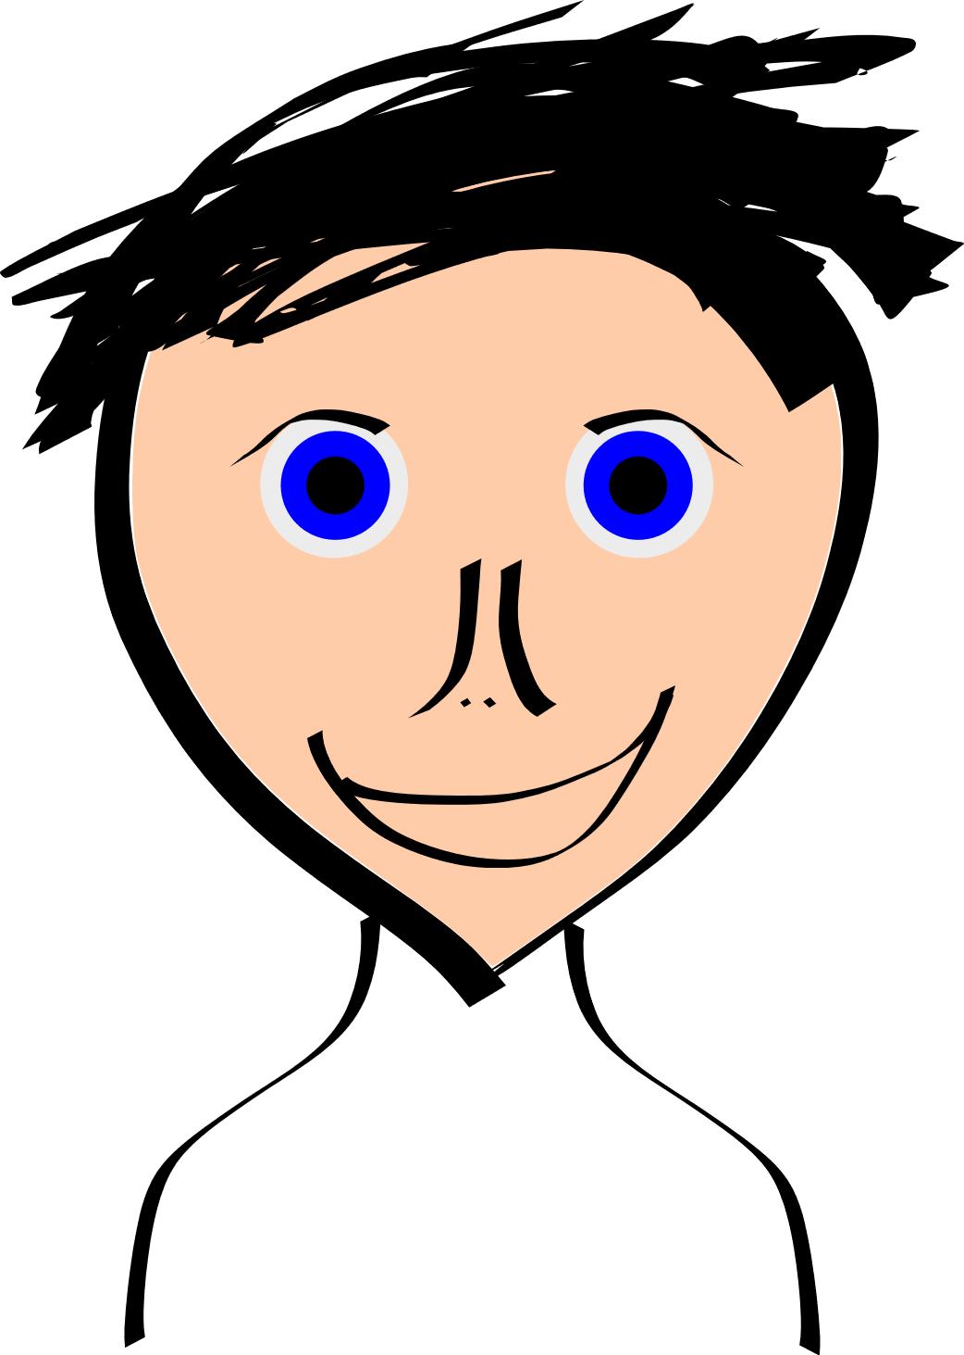
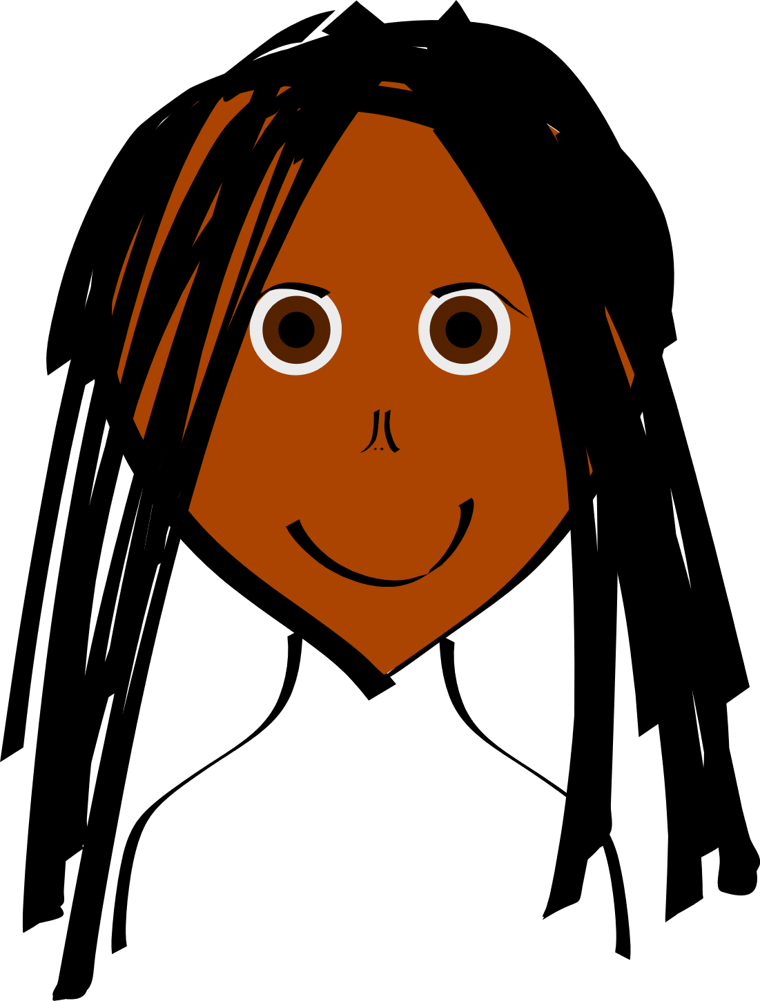
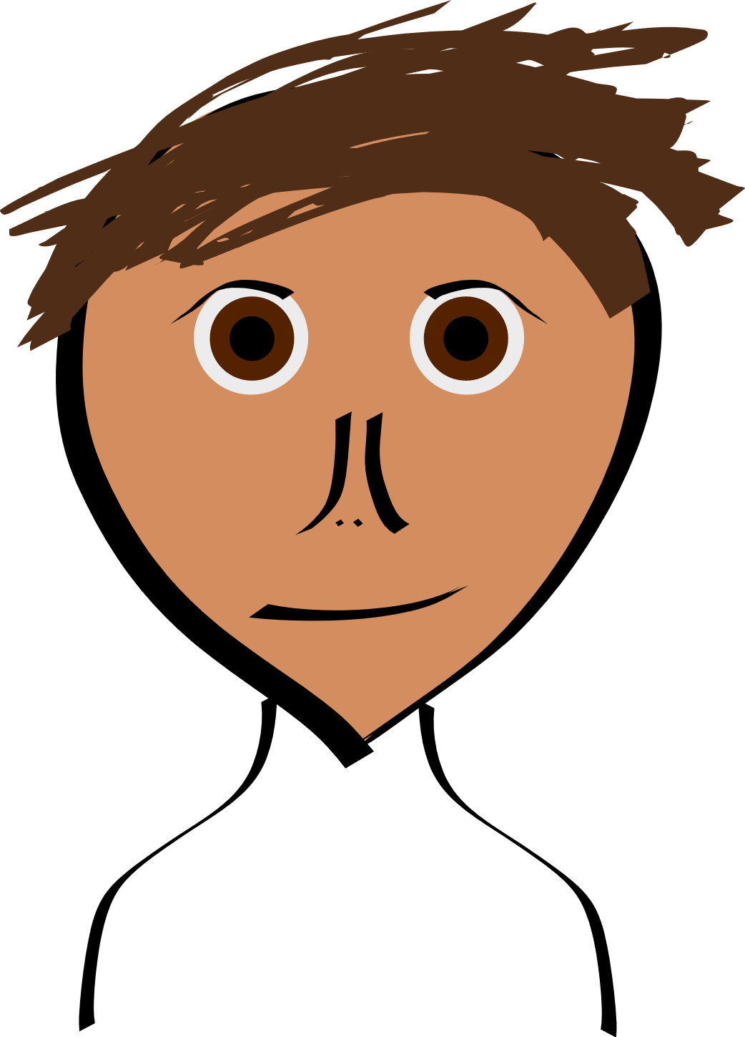
Age: 22
Gender: M
Likeness: Effective
# Choices: Effective
Age: 20
Gender: M
Likeness: Acceptable
# Choice: Poor
Age: 22
Gender: F
Likeness: Acceptable
# Choice: Poor
Age: 21
Gender: M
Likeness: Very Effective
# Choice: Effective
Age: 22
Gender: M
Likeness: Effective
# Choice: Effective
Age: 21
Gender: M
Likeness: Effective
# Choice: Effective
Age: 23
Gender: F
Likeness: Acceptable
# Choice: Acceptable
Age: 22
Gender: M
Likeness: Effective
# Choice: Effective

